Slide 1



Retail Stores
Showrooms
Corporate Offices
We Design, We Build, We Deliver…..
Your dreams….
Visit us at –
Contact us at –
Call us at – +91-9818027859
WhatsApp us at – +91-9818027859
Head Office
Office No - xxx, 1st Floor, Palam Vyapar Kendra, Palam Vihar Rd, Pocket E, Sector 2, Palam Vihar, Gurugram, Haryana 122017

Slide 2
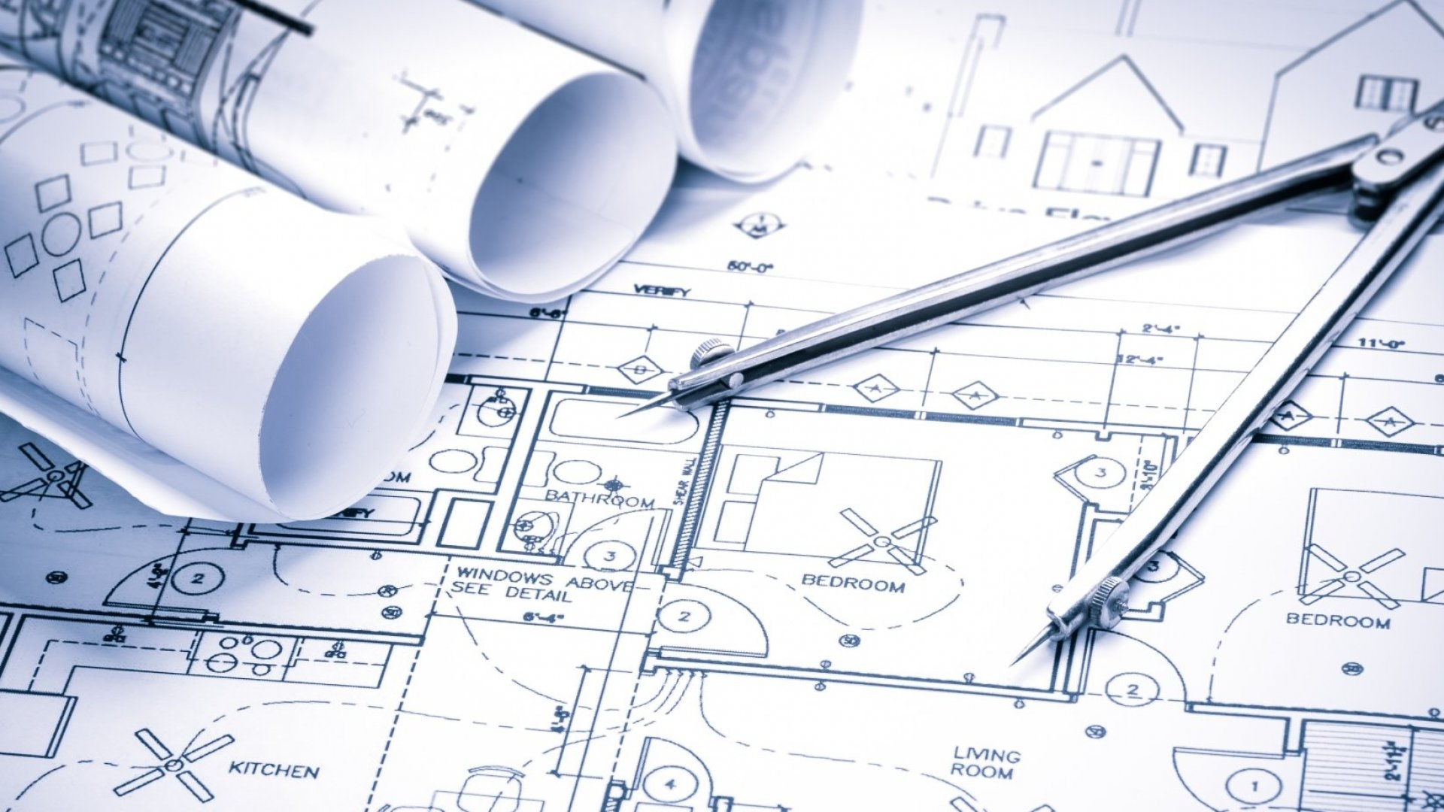
Company Story
Creative Mind is a New Delhi based interior Design & Build Contractor Company that has been providing interior services for your dream offices & ^{Showrooms with} Unpredictable tastes. We are a young firm with a team of professionals who share a passion for the best & therefore are constantly working to provide modern, practical & color conscious designs made to suit your requirements. Our complete execution team can transform your requirements to finely crafted solutions keeping in mind your taste & budget. We offer the same commitment to quality & value throughout
Since the inception of our group in 2019, we have successfully executed several prestigious projects serving a highly discriminating clientele to their full satisfaction. We offer a one point solution to complete corporate interiors. We have long served a highly discriminating clientele to their full satisfaction. And have gained their respect over the years.
For us Large or small projects are treated with the same integrity and dedication leading to high quality results that consistently nail the brief. This has been possible because of observing very high standards of professional integrity and commitment towards our clients so as our policy to give them the best “Value for Money”. Ever since, we had begun, we have made rapid strides by keeping abreast with the advancement in our field and adapting accordingly. Our organization in keeping pace with the changing times has adapted new technologies and expertise to serve the customer to their optimum satisfaction.
.
.
.
.

Slide 3

Our Story
At Creative Mind we believe that people, working together collaboratively, form the basis of competitive advantage in any organization. With that in mind, we strive to improve employee engagement and company performance in all our work with clients. By focusing on both, companies can achieve real change and sustainable advantage over competitors.
The organization was formed by Mr. Praveen Singh, who has over the 18+ years’ experience on Civil interior fit-out field. He has the vast knowledge & experience through the handed over of +200 commercial project to the client with their expected satisfaction level, during this period he has made outstanding relationship with the vendors, suppliers & sub-contractors. Recently He is made his own firm with the experienced team of project manager, engineers, and technicians, skilled & unskilled workers. He is spearheading the Civil & Interior Decoration, Designing & Furnishing Division of Civil - Interiors team, backed by a highly calibre professionals, capable & dedicated of his company. His architectural concepts and meticulous execution has taken the company to new heights.
This organization is run by a group of dynamic young and confident professionals who are capable of handling various types of projects in any part of the country with complete satisfaction of the client.
The company has had the privilege of being associated with some of the leading architects and interior designers in Delhi, Gurgaon, Bangalore, & Mumbai and have created exclusive interiors for wide variety of clients.
.
.

Slide 4

For Our Employee
Develop and maintain strong, trusting relationships with our clients, suppliers, and employees.
Successfully manage growth and guide operations with a strong central support team.
Offer the best working environment for our employees, allowing for creativity and individuality.
Uphold the time-tested values of honesty, trust, and personal integrity.
We offer all team members are focused on achieving excellence in their individual areas while simultaneously coming together to synergize for the greater good. Thus, they live the Values of Creative Mind, every step of the way.
.
.
.
.
.
.

Slide 5
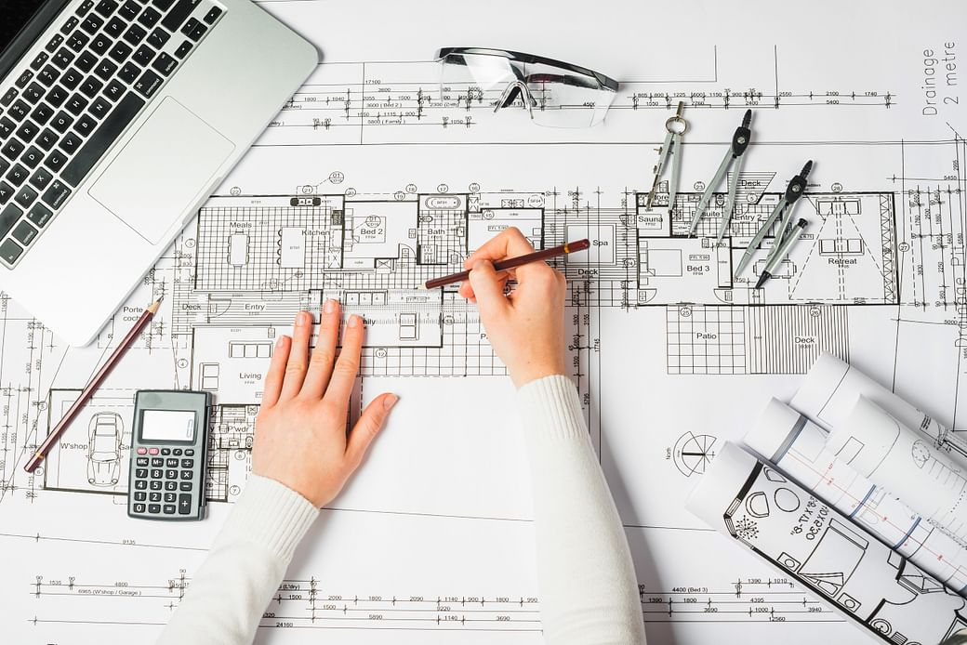
We Offer Our Clients
Premium Interior
Premium Office is the personification of excellence and is a celebration of the Company’s pinnacle of success. It is distinctive and exclusive in its style and is modelled as a masterpiece bordering on the realm of luxury.
Concept Interior
Concept Office is a perfect blend of the complexity of functions and the expression of the Company’s brand. It is delivered in response to the unique client requirements and is elegantly designed with high quality finishes.
Contemporary Interior
.
Contemporary office is a modern, trendy and transparent office, that is highly efficient in its working and is tastefully designed, keeping with a minimalistic approach. It is delivered within a given time frame and on a specified budget.
.
.
.
.
.

Slide 6




Our Wealth
Creative Mind is committed to excellence and we are dedicated to satisfying the construction & interior needs of our customers. Our mission is to provide each client with same exceptional quality & service and to assist in the creation of their project vision.
We at Creative Mind pride ourselves in completing jobs on time, on budget and with the highest level of quality, integrity and commitment. We will strive to create a Code of Excellence throughout the industry & set timelines to complete all of our goals.
Our vision is to deliver quality workmanship with integrity. Our commitment to excellence has become the foundation for each of our projects. We will be the preferred provider for all interiors needs in Delhi NCR. Ourselves never allowing ourselves to be satisfied with the status quo. We will provide the highest quality and product to our clients.
.
.
Our goals are to establish long lasting relationships with our business partners and clients by exceeding their expectations and gaining their trust through exceptional performance.
^{Each} member of the Creative Mind Team will uphold this approach.

Slide 7

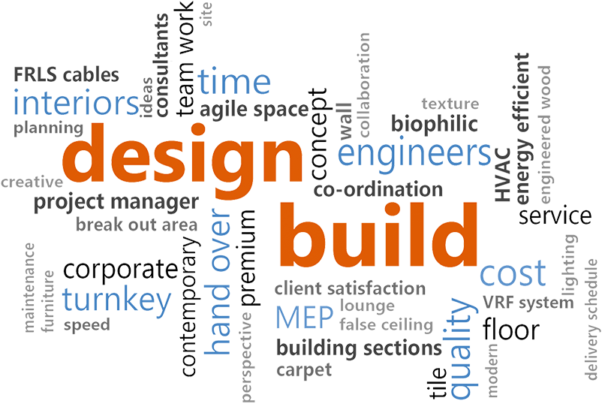
Why Choose Us
.
Clients have an advantage with Creative Mind. Due to in-house design expertise, professional project management team & the skilled worker, Seamless communication between the Design Studio and the Build Team, the concepts and designs created for clients are match to the design during fabrication and installed at the Project site.
Since Team Creative mind executes the Design and Build project with the level best perfection & complete in record time.

Slide 8

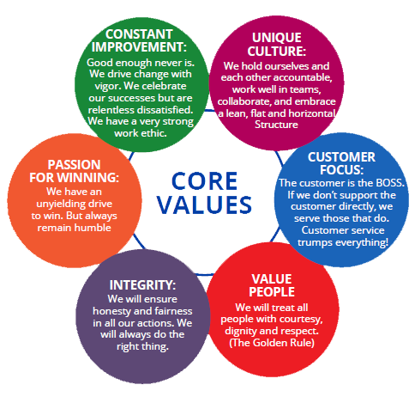
Our Values
.

Slide 9



Our commitment
Creative Mind is committed to quality. we believe that quality is the key to ensuring that our work and the solutions we provide customers will stand the test of time. We take a long view of our work and of our corporate growth. We don’t cut corners for the sake of expediency or to achieve some perceived short-term gain. We want to do the job right and we have developed tools and sought independent verification of our work to ensure that we are delivering the best quality results.
.
Creative Mind, always committed to client satisfaction at the level of 99.99%.
We see our client as invited guests to a party & we are the hosts, it’s our job every day to make every importance aspect of the client experience a little bit better.
We want our clients to feel pampered beyond expectations.
CLIENT SATISFACTION

Slide 10


Our commitment
Creative Mind believes in proper people management, which is parallel to every project because every project is drive on cost and scheduled lines. Hence, we can derive maximum benefits by having distinct Project Management Team interacting with the Architects / Consultants with focus on client’s needs.
PROJECT MANAGEMENT
.
Creative Mind also believes that Unity is strength…. when there is teamwork & collaboration, wonderful things can be achieved.
We run the project from start to end with our enthusiastic & hardworking team members, each & everyone in our workplace always welcoming as member of our team.
TEAMWORK

Slide 11
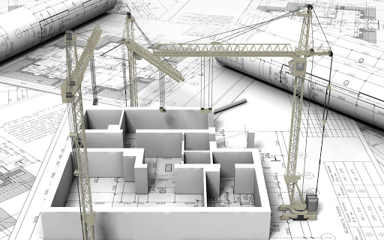
Our Services
Civil Works
We undertake civil works such as renovation and construction according to the requirements of the clients at corporate offices, Showrooms, and residences. Our team of professionals ensures quality work with the latest technology. We offer customized services according to the needs of the customers. Our experts also initiate the process using advanced machinery, expertise and knowledge. Our services are prompt and hassle free.
Interior Fit-Out
We are the leading Interior Decoration and Designing Service provider. Interior designing is an art or process of designing the interior of a room or building. Realize the latest design trends, ideas, and contemporary architectural design and give it a structural mould. It gives you a platform to express the visual art, draw to convey information, express ideas and outline structural possibilities for a better, prosperous and delightful life.
Trunkey Solution
.
We provide our clients reliable and cost-effective Turnkey Interior Designing Solutions as per their diversified needs. Our interior turnkey solutions are ideal for commercial and residential establishments, which include offices, factories, restaurants, showrooms and villas. Right from visualization to detailed designing, we ensure to maintain the highest standards.

Slide 12

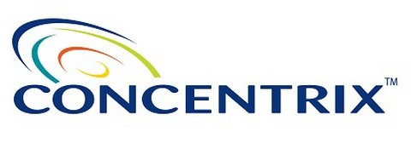




Our Clients
.

Slide 13

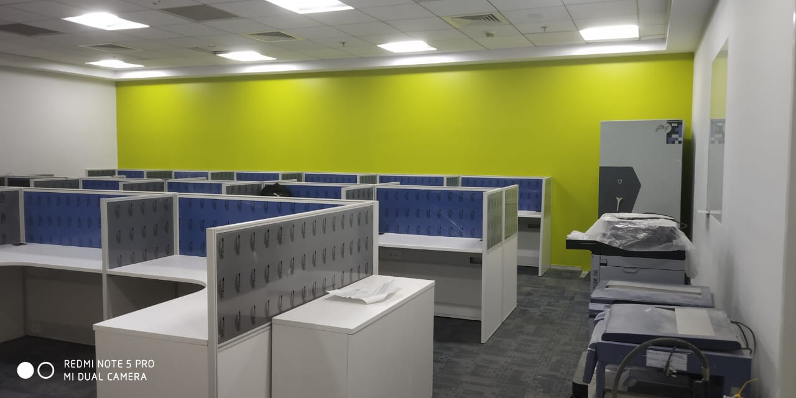
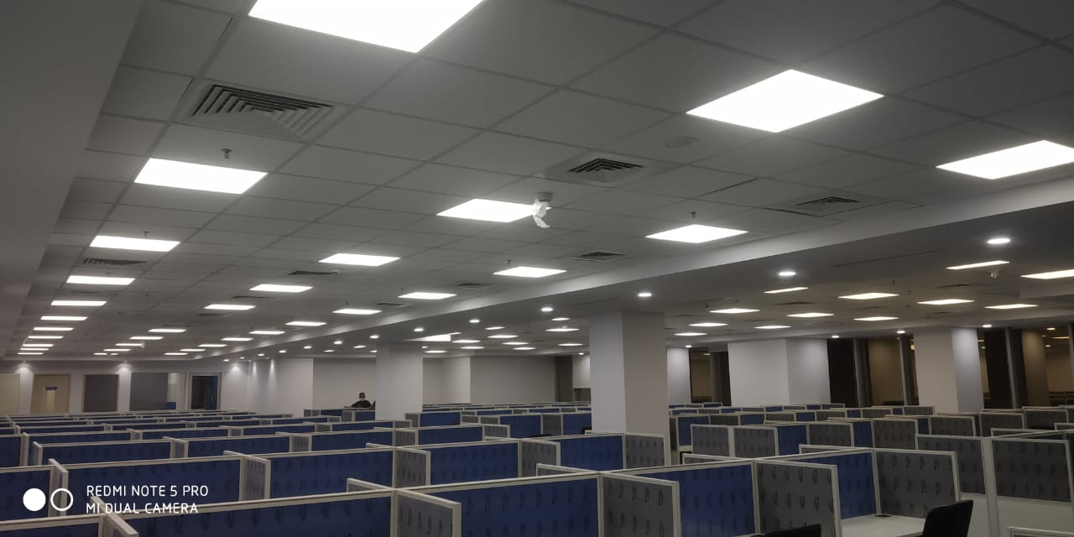
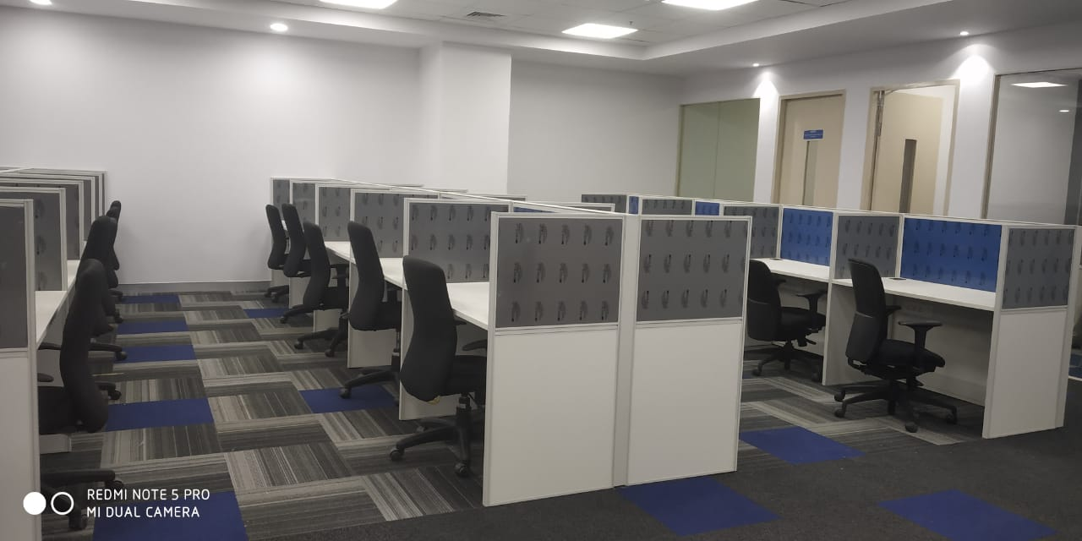
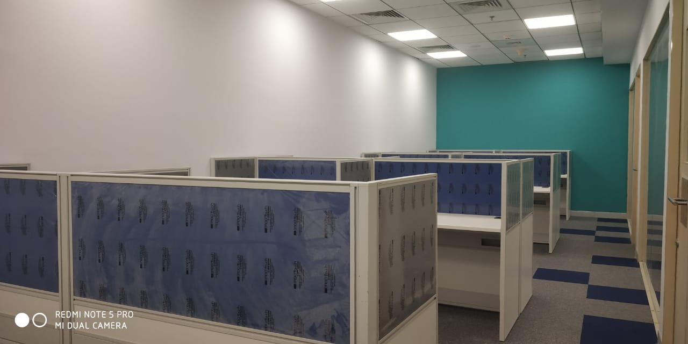
Projects Delivered
Area – 5200 Sqft.
Location – Mumbai
Job – C&I, Electrical
.

Slide 14
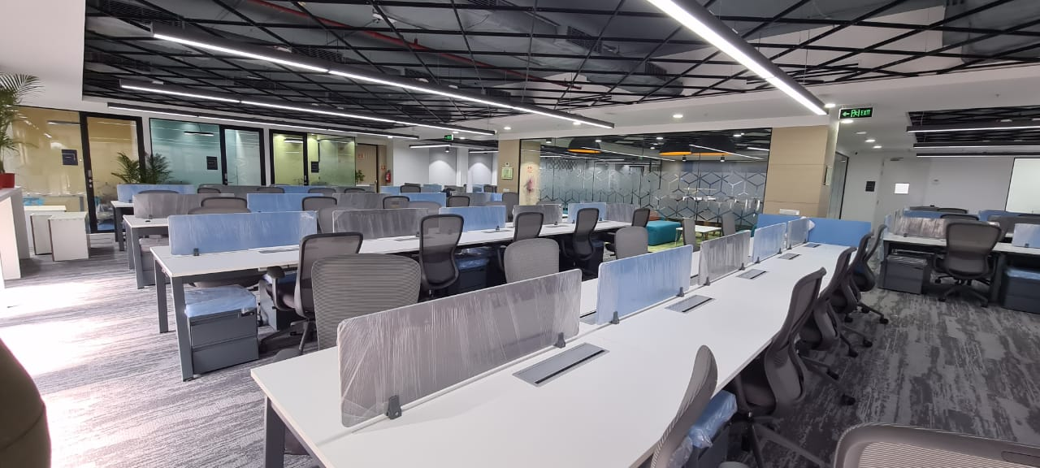
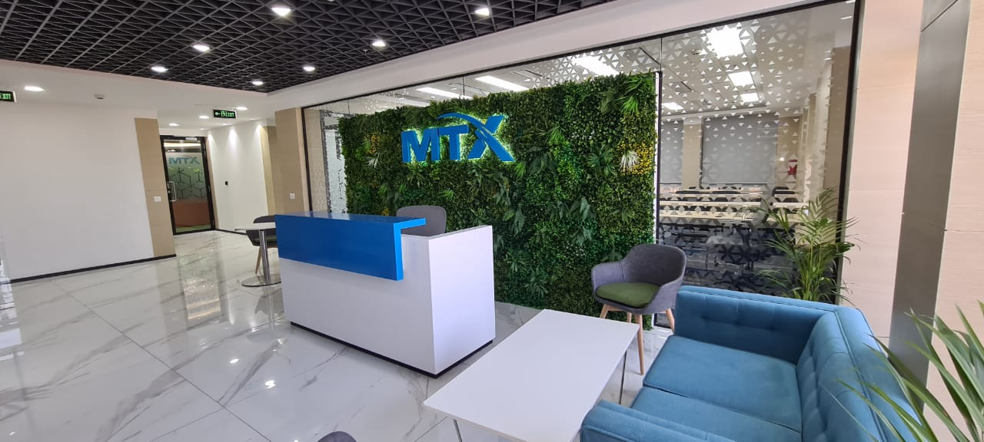
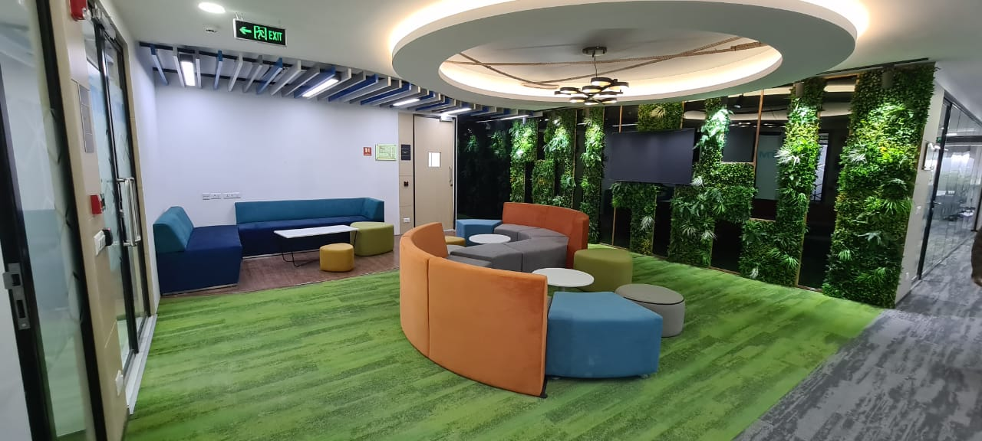
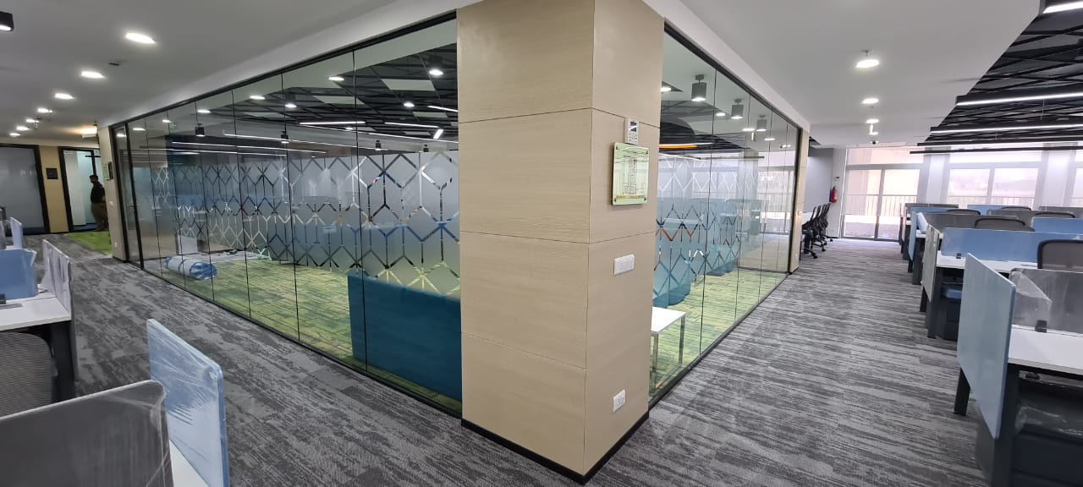
Projects Delivered
Area – 6500 Sqft.
Location – Jaipur
Job – C&I, Electrical, HVAC, Fire&Plumbing.
.

Slide 15

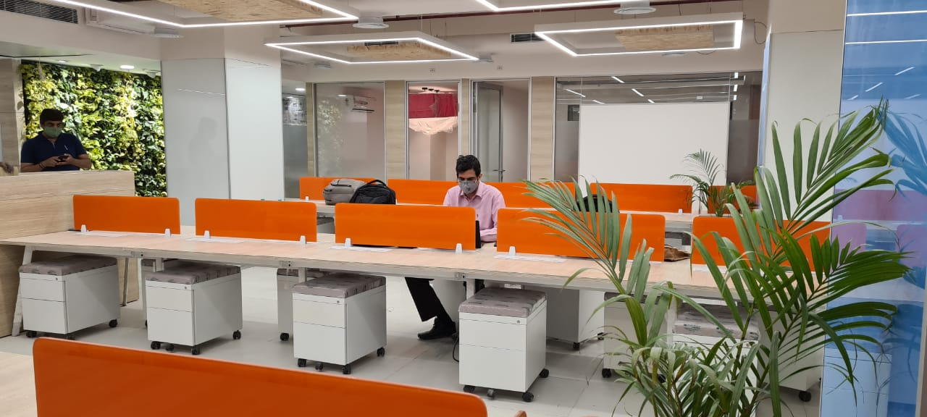
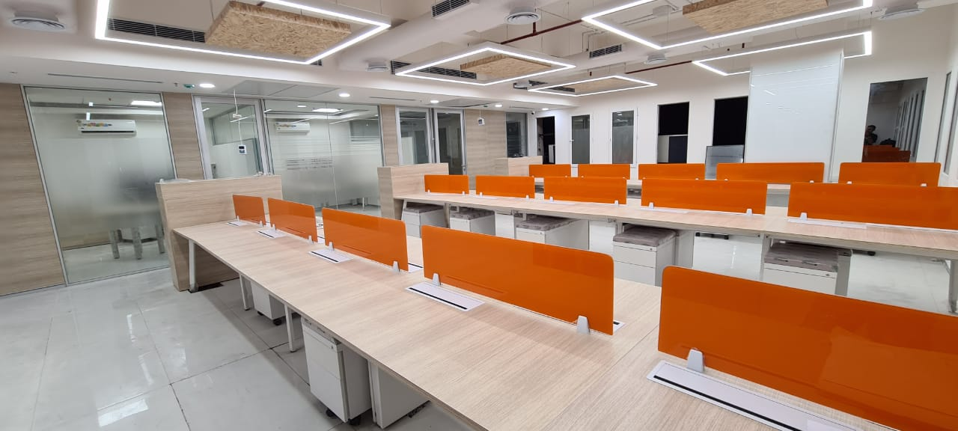
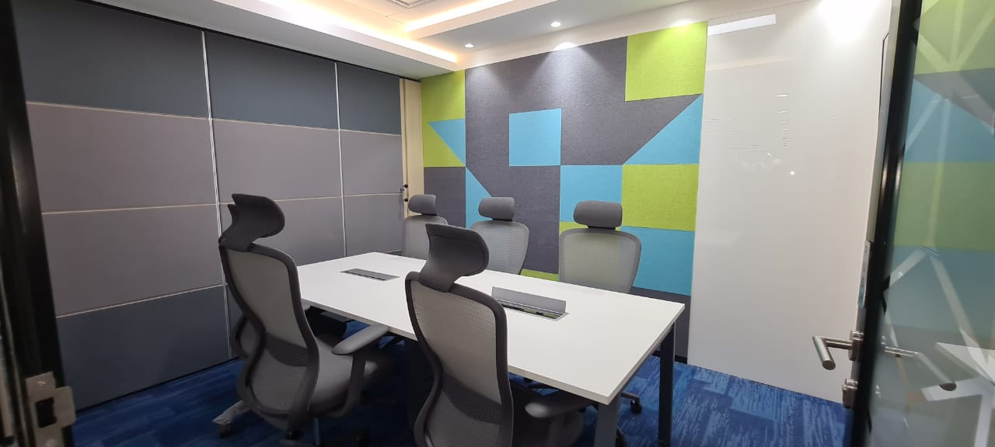
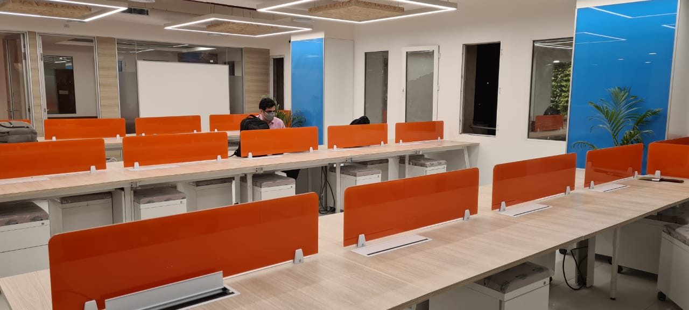
Projects Delivered
Area – 3500 Sqft.
Location – Delhi
Job – C&I, Electrical, HVAC, Fire&Plumbing.
.

Slide 16
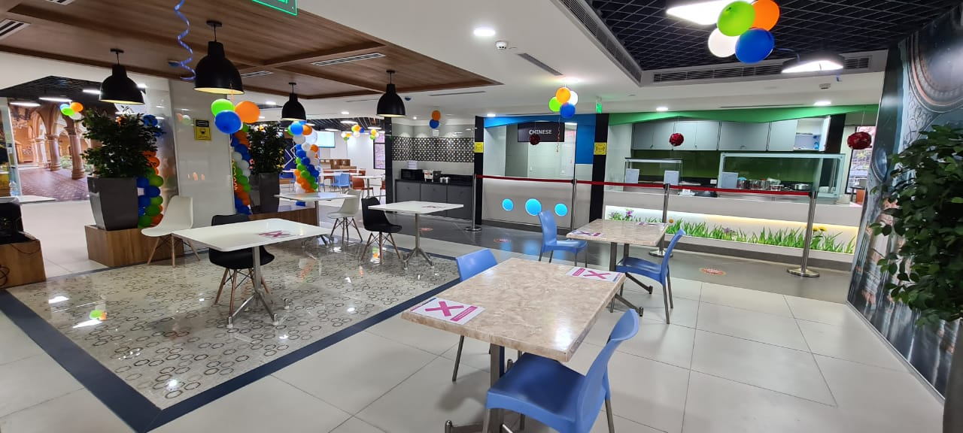
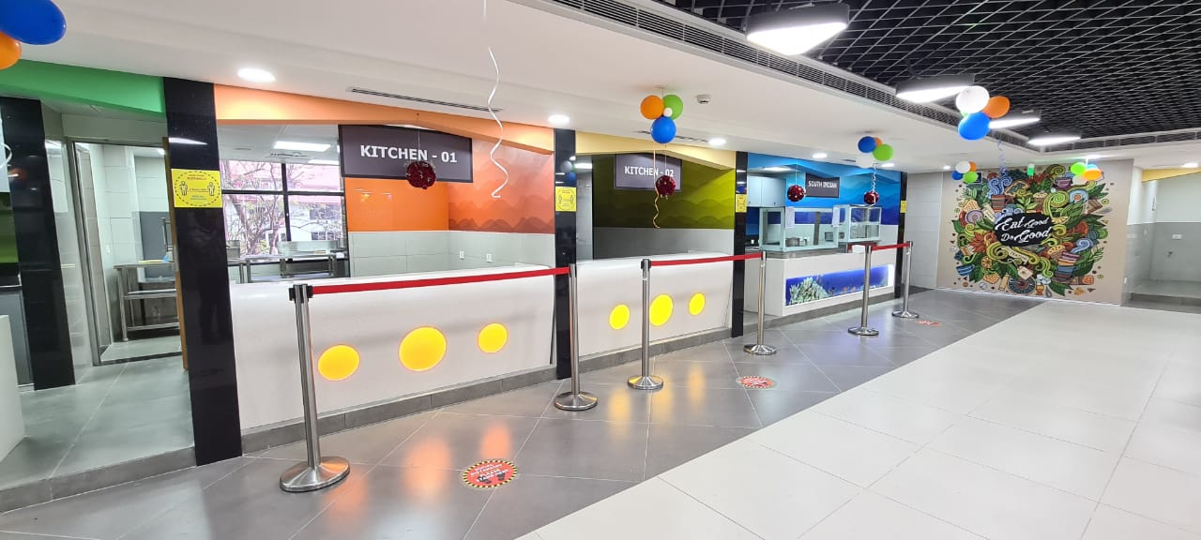
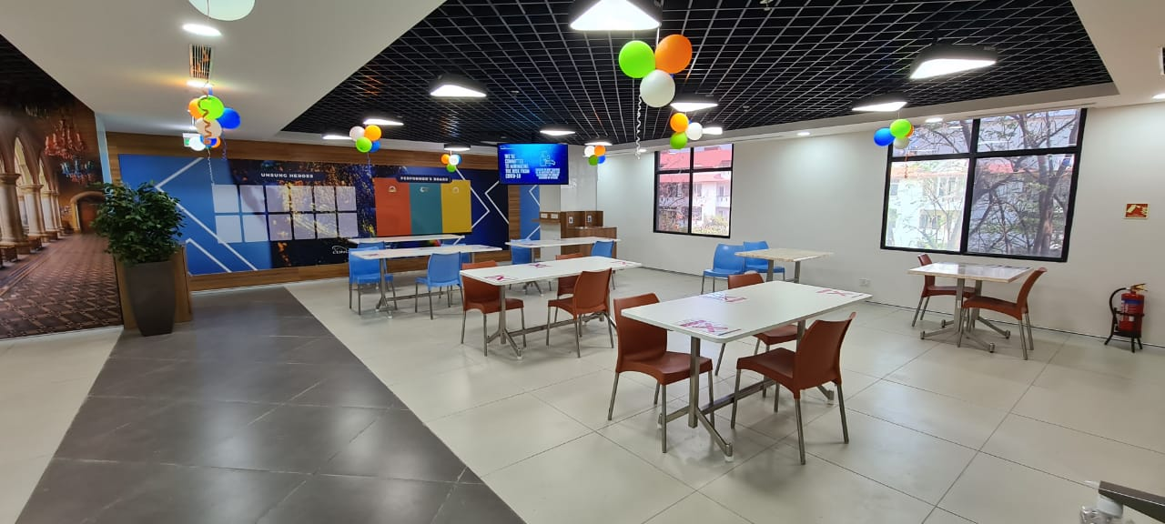
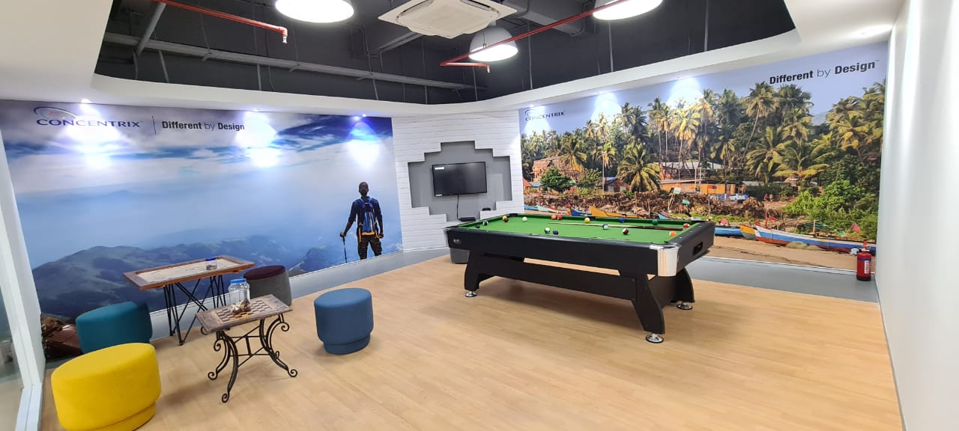
Projects Delivered
Area – 8000 Sqft.
Location – Bangalore
Job – C&I, Electrical, HVAC, Fire & Plumbing
.

Slide 17
Projects Delivered
Area – 8000 Sqft.
Location – Bangalore
Job – C&I, Electrical, HVAC, Fire & Plumbing
.

Slide 18

The Summery
Today, the company is major suppliers of various services in interior designer industry. The company has shown robust growth in its business, which is evident from its top line, which has grown tremendously. The company has also aggressive plans to establish itself as one of the leading interior designer company with the highest level of quality standards and very competitive price.
We, Utilizing our field - proven project to offer truly integrated support services that meet or exceed our client’s expectations and as your business or systems needs change, we can adapt your program to new requirements. Expectations and as your business or systems needs change, we can adapt your program to new requirements. From extended coverage to response time guarantees to new service elements, we can quickly respond to your changing needs. This proactive management style is one important reason for our high rate of customer satisfaction and retention for over a period.
The Creative Mind
We create for you….

